Slide 1

Music recommendation system
Group - 3
Jhanvi Sharma
Kartikey Rai
Pranav Chandra
Priya Ranjan Kar
Yashaswi Singh

Slide 2



Agenda
Project Scope
Data Description
Methodology
Insights
Social & Economic Findings
Actionable Recommendations

Slide 3




Project SCOPE
Objective –
Recommend songs to end user which they would like through data modelling
Stakeholders –
End User
Audio Streaming application/platforms
Musicians / Artists
Music Label companies

Slide 4




Data description
MLUL 2 – GROUP 3
Data taken from Kaggle
10000 rows of raw data set, 8000 rows taken for model
2 data sets used –
-1st – Song IDs, User IDs, Listen Counts
-2nd - Song IDs, Title, Release, Artist Names and Year of Release
Created a new attribute “Song” by merging “Title” and “Artist names” in final merged dataset

Slide 5
Methodology used
We have selected Item Based Collaborative Filtering for our recommendation system
Every song which is played is an item, based on which 2 more similar items are recommended to end user
We have taken 3 methods to achieve the collaborative filtering –
- Cosine Similarity
- Euclidean distance
- Manhattan distance
For Neighbor classifying methodology, Brute algorithm is used since it helped us in picking the item which had the least distance from the song (input) played by the user. This helped us getting accurate recommendations

Slide 6
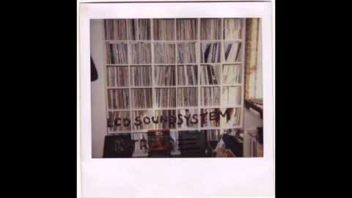
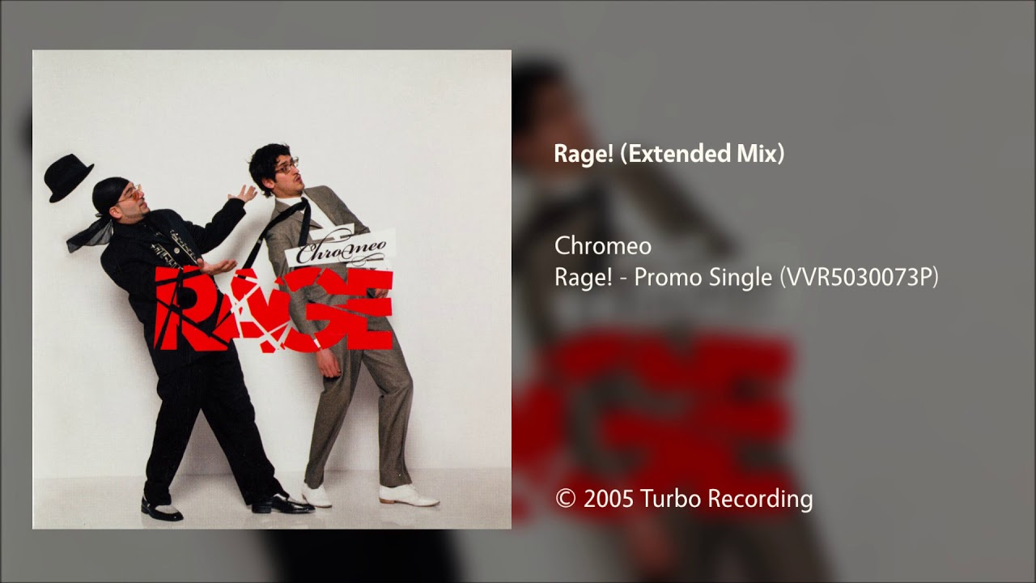

insights
Relatable items found – input one song – recommended 2 outputs based on songs which have listening count > 0
Modelling on current data set using – neighbor’s classifiers with brute algorithm
Accuracy of 0.52, avg F1-0.53, precision score – 0.53, recall – 0.53
Input: Song index = 56; Input Song Name: Too Much Love - LCD Soundsystem
- The Nearest songs to song: [56, 55, 59]
- The Distance from song: [1.4142135623730951, 1.4142135623730951]
- Recommended song:
=> 59 = Rage! - Chromeo
=> 55 = Everything Will Be Alright - The Killers

Slide 7
Social & economic findings
Better recommendations with maximum accuracy resulting in application popularity with increase in new users
Higher number of subscriptions, higher revenue
Better partnerships with artists & music labels
Enhance ongoing data collection results in refined accuracy and targeted marketing
Average consumption value growth

Slide 8
Actionable recommendations
Data format and data type should be maintained
Real time recommendations require higher computational resources
Test size needs to be not more than 0.15 to avoid delayed execution and index and distance calculation
Data set should have every song played at least once by end user
Regular updates, maintenance and debugging

Slide 9

Thank you

